Slide 1
Cryogenic Safety with Emphasis on Overpressure Protection of Low Temperature Helium Vessels
Tom Peterson, SLAC
USPAS
January, 2017

Slide 2
Two MRI system event videos
http://www.youtube.com/watch?v=1R7KsfosV-o
http://www.youtube.com/watch?v=sceO38idjic&feature=related

Slide 3
Outline
Introduction
The basic hazards – selections from a general cryogenic safety training class
Lessons learned from accidents
Cryogenic pressure safety
ODH analysis

Slide 4
Introduction
The purpose of this lecture is to provide a review of cryogenic safety and pressurized gas hazards
Most commonly used cryogenic fluids in accelerator work are argon (Ar), nitrogen (N2), helium (He) and hydrogen (H2). These fluids are used in liquid and gaseous form.
These low temperature fluids have the potential for creating dangerous working environments.
Everyone who works with cryogenic fluids must know their hazards and how to work safely with them.
4

Slide 5
The basic hazards due to helium and nitrogen
Freezing, extreme cold
  Burns skin, eyes
  Embrittlement of material
Pressure, force of blast, propelled objects
  Dust, debris
  Pipe cap, valve stem and bonnet
  Expansion in a closed volume
Noise
  Compressors
  Gas vents
ODH--Oxygen Deficiency Hazard
  Nitrogen
  Helium
Fire -- hydrogen burns easily and with a clear flame
Oxygen enriched air -- enhanced burning of flammable materials

Slide 6
Oxygen Deficiency Hazard (ODH)
Oxygen Deficiency Hazard (ODH) is caused due to oxygen displacement.
ODH is a serious hazard usually occur without any warning
ODH is addressed by Fermilab’s FESHM 5064, which is available via the Fermilab web site.
The cold, heavy gas from evaporating cryogenic liquid does not disperse very well and can group together in surrounding areas and will displace air.
Some gases (He, H2) while cold may be lighter than air. They may partially mix with surrounding air, or stratify as they warm up.
A hazard with helium and other inert gases is to have a pockets of trapped gas up high in a building, which may cause ODH. (A concern is that a person could pass out and fall off a ladder when replacing a lamp, for example.)
Be aware of the hazards associated with large volumes of cryogens in a small space (for example, rolling a 160 liter LN2 dewar into a small room)
6

Slide 7
Extreme cold hazard
Cryogenic liquids and cold vapors can cause a thermal burn injuries
Brief exposures may damage delicate tissues (eyes, skin, etc).
The skin, when not protected, can stick to metal that is cooled by cryogenic liquids and when pulled away the skin can tear
Even non-metallic materials are very dangerous to touch at cryogenic temperatures
7

Slide 8
Fire Hazard
Flammable cryogenic gases like H2 can burn or explode
Hydrogen is colorless, odorless, non-toxic, highly flammable and explosive in the presence of air or oxygen in the right concentration. It forms a flammable mixture when it exists at 4 to 74%. Hydrogen, since it is lighter than air, will tend to form pockets of gas along ceilings, which can lead to an explosion or fire hazard.
A flashing or rotating blue light is used at Fermilab to indicate that hydrogen is present in experimental apparatus in the area. Typically other institutions will also provide similar warning signals.
Further training is required for qualification for working with hydrogen
8

Slide 9
Oxygen Enriched Air
Cryogenic fluids like LHe, LN2 and LH2 can easily liquefy the air they come in contact with.
Liquid air can condense on a surface cooled LHe, LN2 and LH2 .
N2 has smaller latent heat than Oxygen (O2), thus evaporates more rapidly than oxygen from the liquid air. This action leaves behind a liquid air mixture which, when evaporated, gives a high concentration of oxygen.
This O2 enriched air presents highly flammable atmosphere.
9

Slide 10
Over Pressurization or Explosion due to rapid expansion
Without adequate venting or pressure-relief devices on the containers, enormous pressures can build up which can cause an explosion.
Unusual or accidental conditions such as an external fire, or a break in the vacuum which provides thermal insulation, may cause a very rapid pressure rise.
The pressure relief valve must be properly installed and free from obstruction.
1/5/2017
10

Slide 11
Protection from cryogenic hazards
Always wear personal protective equipment while handling cryogenic liquids. This includes: gloves, face shields, hearing protection, loose fitting thermal insulated or leather long sleeve shirts, trousers, safety shoes
Only trained and qualified personal should be allowed to handle, transport or storing liquefied gases.
Proper storage is essential for cryogenic fluids
Depressurize system
Stand aside from vent
Be aware of closed volumes into which liquid cryogens might leak
Do not leave open mouth dewars open
Purge and evacuate all equipment before operation
Use cryogens in a properly ventilated areas only
11

Slide 12
Lessons Learned
The following are a set of “lessons learned” which have been compiled from various sources. One primary source of lessons learned is the American Industrial Hygiene Association, which has a section of their website describing several cryogenic accidents: http://www2.umdnj.edu/eohssweb/aiha/accidents/cryogens.htm has been used as a source of some different examples of cryogenic hazards.

Slide 13
Lessons Learned
Empty 55 gallon drum (1999)
  At the Nevada Test Site, a waste handler was opening new, empty 55 gallon open-top drums. Upon removing the bolt from the drum lid clamp, the ring blew off and the lid was ejected approximately 5 to 10 feet in the air, just missing the Waste Handler's face. The drum did not hiss or show signs of pressurization.
  Because the Waste Handler had been properly trained to stand away from the drum while opening it, he was not injured.
  The event was caused by the drums being manufactured and sealed at sea level in Los Angeles and subsequently shipped to a much higher elevation of approximately 6,000 feet at the Nevada Test Site. The increased elevation, combined with the midday heat, created sufficient pressure buildup to cause the lid to blow off when the ring was being released.
  Lesson -- large force with small pressure times large area

Slide 14
Lessons learned (continued)
50 liter LN2 laboratory dewar explosion
  Transfer of LN2 from 160 liter dewar to 50 liter “laboratory” dewar
  Flex hose end from 160 l dewar would not fit in lab dewar neck (normally a “wand” is inserted for filling), so a connection was made with rubber hose over the OUTSIDE of the lab dewar neck and transfer hose end
  “Slot” cut in rubber hose for vent
  Failure not initially caused by overpressure, but by cooling of upper part of neck during fill! Seal between neck and vacuum jacket broke due to differential thermal contraction.
  Seal to vacuum jacket broke after lab dewar nearly full, subsequent overpressure with lack of sufficient vent caused explosion of lab dewar
  One person badly injured
  Lesson -- rupture of insulating vacuum with restricted venting resulted in explosion

Slide 15
Lessons learned (continued)
Two workers at a Union Carbide plant were inspecting a flange surface on a 48” diameter pipe with an ultraviolet light.
They draped black plastic over the end of the pipe to create shade for seeing any glow from material in the ultraviolet.
The workers did not know there were some sources of nitrogen connected to the pipe. In fact, one of the workers had helped to start a purge on another section of pipe. But the system was so complex, he did not know they were connected.
When they went under the cover to do the inspection, both workers quickly passed out from lack of oxygen. One died; the other was seriously injured.
OSHA ultimately cited the company for violation of the confined space entry standard.
Lesson -- be aware of potentially confined spaces, possible unlabeled ODH hazards

Slide 16
Topics in cryogenic pressure safety
ASME pressure vessel code, ASME pressure piping code
  We will not discuss vessel or piping code details, just provide some references to relevant sections
Sources of pressure
Thermodynamics of cryogen expansion and venting
Analytical methods for vent line and relief sizing
Relief devices
Example of a venting system analysis
Examples of the impact on cryostat design
Oxygen Deficiency Hazard (ODH) analysis
Conclusions and references

Slide 17
Pressure vessel and piping codes
ASME Boiler and Pressure Vessel Code and ASME B31 Piping Codes
  I will not go into detail about the design of pressure vessels or piping per ASME code
    Will focus on emergency venting and system issues
  In general, we try to purchase vessels built to the code from code-authorized shops
  Where code-stamping is not possible, we design (or specify designs) to the intent of the code and note implications of exceptions to the code
Fermilab’s ES&H Manual (FESHM) pressure vessel standard, FESHM 5031, is available online at http://esh-docdb.fnal.gov/cgi-bin/ShowDocument?docid=456

Slide 18
ASME pressure vessel code -- Section VIII, Division 1
“Div. 1 is directed at the economical design of basic pressure vessels, intending to provide functionality and safety with a minimum of analysis and inspection. Rules are presented which, if applicable, must be used. Common component geometries can be designed for pressure entirely by these rules. Adherence to specified details of attachment eliminates the need for detailed analysis of these features for pressure loading. NDE of welds can typically be avoided by taking a penalty in overall thickness of a component.”
Quoted from “Guidelines for the Design, Fabrication, Testing and Installation of SRF Nb Cavities,” Fermilab Technical Division Technical Note TD-09-005

Slide 19
ASME pressure vessel code -- Section VIII, Division 2
“Div. 2 is directed at engineered pressure vessels, which can be thought of as vessels whose performance specifications justify the more extensive analysis and stricter material and fabrication controls and NDE required by this Division. Thus, while a Div. 2 vessel is likely to be more efficient than a Div. 1 vessel in terms of total material used, this efficiency is accompanied by increased design and fabrication cost.”
Quoted from “Guidelines for the Design, Fabrication, Testing and Installation of SRF Nb Cavities,” Fermilab Technical Division Technical Note TD-09-005

Slide 20
Pressure protection
Vessel and piping have a Maximum Allowable Working Pressure (MAWP) defined by the design of the vessel or system
  A venting system and relief devices must be in place to prevent any event from pressurizing the vessel or piping above the MAWP (plus whatever code allowance may be available)
Evaluate all pressure sources and possible mass flow rates
Size the vent line to the relief device
  Temperature and pressure of flow stream
  Typically a pressure drop analysis for turbulent subsonic flow
Size the relief device
Size downstream ducting, if any
  Downstream piping may be necessary to carry inert gas safely away from an occupied area or sensitive equipment

Slide 21
ASME pressure vessel code -- relief devices
Section VIII of the ASME Code provides fundamental guidance regarding pressure relief requirements.
  ASME Section VIII, Division 1, UG-125 through UG133, for general selection, installation and valve certification requirements
  ASME Section VIII, Appendix 11 for flow capacity conversions to SCFM-air
For Div. 2, relevant information is found in Part 9.

Slide 22
Compressed Gas Association publication,
CGA S-1.3, “Pressure Relief Device Standards”
Extensive guidance on requirements for relief devices consistent with ASME code
  Applicable where MAWP and venting pressure exceed 15 psig
I will not provide a detailed discussion of CGA S-1.3, but rather just point to a few key issues and most useful elements of the standard

Slide 23
Note: we take exception to paragraph 2.2 in CGA S-1.3
“CGA believes that reclosing PRDs on a container shall be able to handle all the operational emergency conditions except fire, for which reclosing or nonreclosing PRDs shall be provided. The operational emergency conditions referred to shall include but not be limited to loss of vacuum, runaway fill, and uncontrolled operation of pressure buildup devices.”
Exception: we treat loss of insulating vacuum to air, with the very high heat flux resulting from condensation on the liquid helium temperature surface of a container, like the fire condition and may use nonreclosing relief devices for that situation

Slide 24
Compressed Gas Association publication,
CGA S-1.3, “Pressure Relief Device Standards”
From CGA S-1.3: Among the particular issues which must be addressed for low temperature vacuum jacketed helium containers are
  the temperature at which liquid-to-gas evolution should be estimated for the supercritical fluid at its venting pressure (CGA S-1.3 is very useful here; I’ll discuss this)
  the warming of the cold fluid passing through a long vent line (CGA S-1.3 also provides useful practical approximation methods here which I will discuss)
  the volume generated per unit heat added (we have data from lab tests about this which provide useful numbers)

Slide 25
Evaluating the venting flow rate and conditions
Berkeley MRI magnet quench
https://www.youtube.com/watch?v=QRahBusouRs

Slide 26
Sources of pressure -- mechanical
Compressors, pumps
  Screw compressors are positive displacement devices
  Worst case flow may be with high suction pressure as limited by inlet-side reliefs or pump/compressor motor power
    Calculate worst-case flow as highest inlet density combined with known displacement volume
    Or consider power limitations of pump or compressor motor
Connection to a higher pressure source, such as a tube trailer
  Evaluate the mass flow as determined by the pressure drop from the highest possible source pressure to the MAWP of vessel to be protected

Slide 27
Sources of pressure -- heat
Trapped volume, slow warm-up and pressurization with normal heat inleak
  All possible volumes which may contain “trapped” (closed off by valves or by other means) cold fluid require small reliefs
  Rate of warm-up may be evaluated, generally slow enough that trapped volume reliefs are not individually analyzed.
Loss of vacuum to helium with convection and conduction through helium gas
Sudden large heat influx to a liquid-helium temperature container due to condensation of nitrogen or air on the surface
  Either through MLI or, worst-case, on a bare metal surface
Stored energy of a magnetic field
  May provide a larger flow rate than loss of insulating vacuum
Fire, with heat transport through the gas-filled insulation space

Slide 28
Nominal heat loads
Working numbers for making heat load estimates
  ~1.5 W/m² from 300 K to MLI-insulated (typically about 30 layers) cold surface
  ~50 mW/m² from 80 K to MLI-insulated (typically about 10 layers) 4.5 K or 2 K surface
Note that support structures and “end effects” may dominate the total heat load

Slide 29
Heat flux due to loss of insulating vacuum as a source of pressure
W. Lehman and G. Zahn, “Safety Aspects for LHe Cryostats and LHe Transport Containers,” ICEC7, London, 1978
G. Cavallari, et. al., “Pressure Protection against Vacuum Failures on the Cryostats for LEP SC Cavities,” 4th Workshop on RF Superconductivity, Tsukuba, Japan, 14-18 August, 1989
M. Wiseman, et. al., “Loss of Cavity Vacuum Experiment at CEBAF,” Advances in Cryogenic Engineering, Vol. 39, 1994, pg. 997.
T. Boeckmann, et. al., “Experimental Tests of Fault Conditions During the Cryogenic Operation of a XFEL Prototype Cryomodule,” DESY.

Slide 30
Heat flux conclusions
Lehman and Zahn
  0.6 W/cm² for the superinsulated tank of a bath cryostat
  3.8 W/cm² for an uninsulated tank of a bath cryostat
Cavallari, et. al.
  4 W/cm² maximum specific heat load with loss of vacuum to air
Wiseman, et. al.
  3.5 W/cm² maximum peak heat flux
  2.0 W/cm² maximum sustained heat flux

Slide 31
Other heat flux comments
T. Boeckmann, et. al. (DESY)
  Air inflow into cavity beam vacuum greatly damped by RF cavity structures
Various authors also comment about layer of ice quickly reducing heat flux
Heat flux curves for liquid helium film boiling with a delta-T of about 60 K agree with these heat flux numbers (next slide)
I use 4 W/cm² for bare metal surfaces

Slide 32
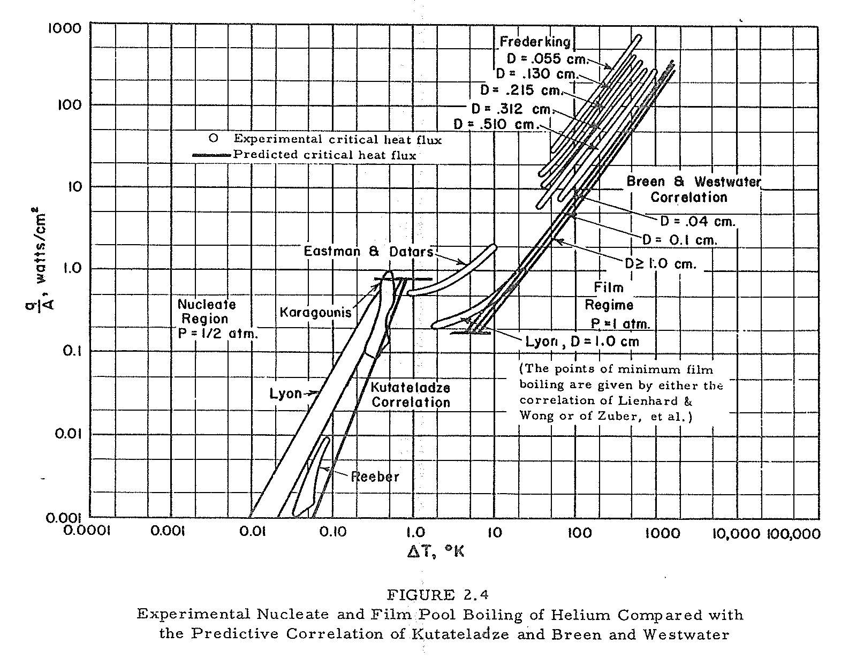
E. G. Brentari, et. al.,
NBS Technical Note 317

Slide 33
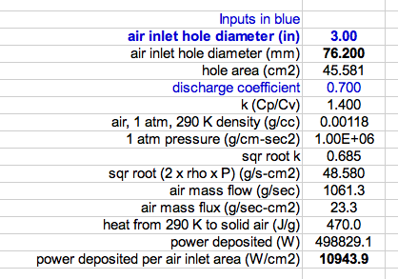
Atmospheric air rushing into a vacuum space and condensing on a surface deposits about 11 kW per cm² of air hole inlet area. In many cases, heat flux will be limited by this air hole inlet size rather than low-temperature surface area.

Slide 34
Conversion of heat to mass flow
Low pressures, below the critical pressure
  Latent heat of vaporization
  Net flow out is vapor generated by the addition of heat minus the amount of vapor left behind in the volume of liquid lost
High pressures, above the critical pressure
  Heat added results in fluid expelled
  A “pseudo latent heat” can be evaluated

Slide 35
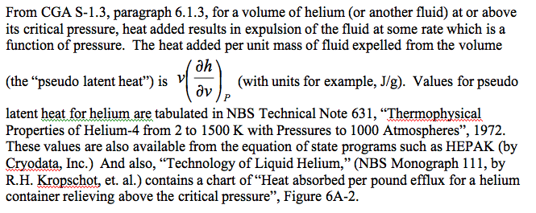
Supercritical fluid -- energy added per unit mass expelled
The pressure of a liquid helium container during venting will often exceed the critical pressure of helium (2.3 bar)

Slide 36
Relief venting
Up to now, we have discussed estimation of the venting flow rate
In summary
  We have a vessel or piping MAWP
  We have a mass flow rate provided either by compressors/pumps or heating of low temperature fluid which must be removed from that vessel at or below the MAWP

Slide 37
Venting flow analyses
Size piping to the relief device
Size the relief device
  Typically using the vendor-provided or standard relief device formulas and charts
Size piping downstream of the relief device
A somewhat different venting flow analysis -- estimate flow from a rupture or open valve into a room for an ODH analysis

Slide 38
Constraints and assumptions
For relief and vent pipe sizing
  Typically flow driven by a Maximum Allowable Working Pressure (MAWP, as defined by code requirements) at the vessel
  Pipe size and relief device size are the free parameters
    Perhaps also pipe routing
  Flow rate may be determined by a compressor or pump capacity or heat flux to a low temperature vessel

Slide 39
Constraints and assumptions
For ODH analysis
  Pipe size may not be a free parameter
    Analyses are often done for existing systems
  A flow estimate is based on worst-case pressures and rupture or open valve assumptions
    Worst-case in terms of maximum flow of inert gas

Slide 40
Venting and relief sizing analysis
Conservative, err on the safe side
  Venting is typically not steady-state, very dynamic
  Make simplifying assumptions on the safe side
    For example, flow rate estimate should be safely on the high side for relief sizing
Reviewable
  Simplest and most straightforward analysis which demonstrates requirement
  Of course, more sophisticated analysis (such as FEM fluid dynamic simulation may be necessary for a system with sever constraints)

Slide 41
Vent sizing vs ODH flow estimate
Vent sizing goal is to show that venting system (piping and relief devices) carry flow which starts at or below MAWP
  So pressure drop estimate may be conservatively high so as to end with a conservatively low flow rate and verify safely large vent system size
ODH venting analysis may be to estimate flow of inert gas into a space
  So pressure drop estimate may be conservatively low so as to end with a conservatively high flow rate and verify safely large room ventilation

Slide 42
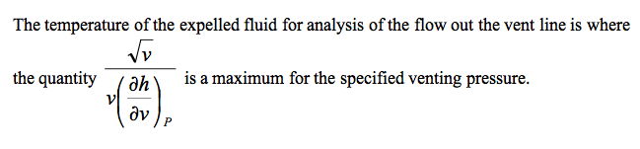
Vent line flow temperature
This exit temperature will typically be 5 K - 6 K
for a liquid helium container venting at a somewhat
supercritical pressure.
The temperature into the relief device may be higher than the exit
temperature due to heat transfer to the flow via the vent pipe. For
very high flow rates and a relatively short vent line, this temperature
rise may be insignificant. A simple energy balance on the flow and
stored energy in the vent line, with an approximate and conservatively
large convection coefficient may provide a safely conservative
estimate of the temperature rise. For a long vent line, a more detailed
analysis may be required in sizing the relief device. CGA S1.3,
paragraph 6.1.4 and following, provides some guidance for this analysis.

Slide 43
Vent line pressure drop evaluation

Slide 44
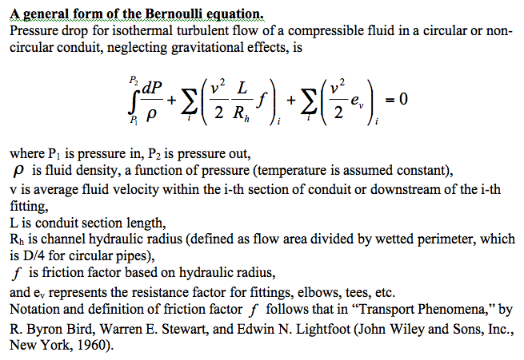

Slide 45
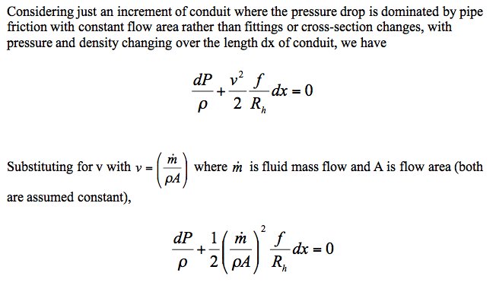

Slide 46
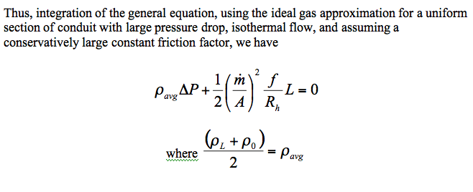
The point of this little derivation is to show that for sections of pipe
with large enough pressure drop that density and velocity changes
are significant, iterating pressure drop calculations to come up with
a linear average density through the section of constant cross section
gives a good estimate of pressure drop.

Slide 47
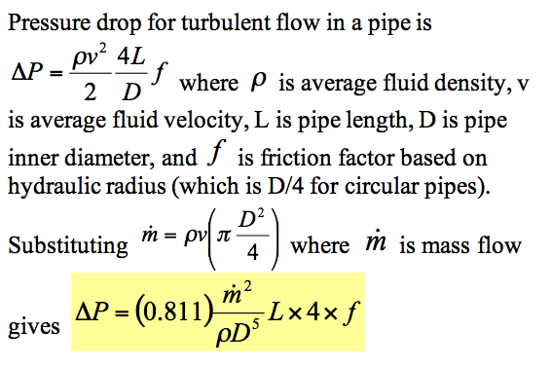
Pressure drop analysis, working formula for round pipes
This is a form of the D'Arcy-Weisbach formula. With pressure drop expressed as head loss, this is sometimes called simply the Darcy formula.
(Note that delta-P changed signs here, to a positive number.)

Slide 48
Rupture disk and relief valve sizing
Flow will typically be choked (sonic) or nearly choked in a relief valve or rupture disk
  Inlet pressure is at least 15 psig (1 atm gauge) for ASME approved relief devices
  Discharge is to atmosphere
This makes analysis relatively simple
  Relief valve catalogues and rupture disk catalogues have good, practical working formulas and charts for sizing relief devices

Slide 49
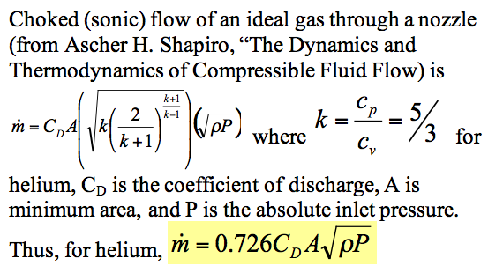
Choked flow in a nozzle

Slide 50
Crane Technical Paper #410
Crane Technical Paper #410 “Flow of Fluids through Valves, Fittings, and Pipes”
A classic reference, still available in updated forms
Contains many forms of Bernoulli Equation and other formulas for both compressible and incompressible flow
Relief valve and rupture disk catalogue formulas often reference Crane Technical Paper #410
My only criticism (and strictly my personal opinion) -- I do not like the incorporation of unit conversions into formulas, which is too common in these engineering handbooks

Slide 51
Relief devices
For cracking pressures of 15 psig or higher, ASME-approved (UV- or UD-stamped) pressure relief devices may be used.
For vessels with a differential pressure of more than 15 psid within the vacuum jacket but a gauge pressure of less than 15 psig, ASME-approved reliefs are not available.

Slide 52
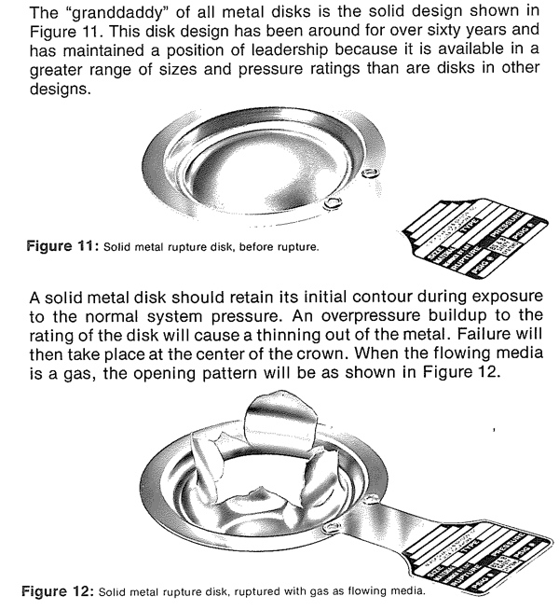
From the BS&B rupture disk catalogue

Slide 53
Rupture disks
Various types, some pre-etched or with knife edge, or failure in collapse (pressure on the dome) and other designs and materials
  Difficult to set a precise opening pressure
A last resort device since they do not close
  You don’t want these opening in normal operations
  Switching valves available for dual disks such that one can be replaced while the other holds pressure and provides protection
Inexpensively provide very large capacity, so typical for the worst-case loss of vacuum
  Operational reclosing relief valves set at a safely lower pressure (80% of RD or less) prevent accidental opening of the rupture disk

Slide 54
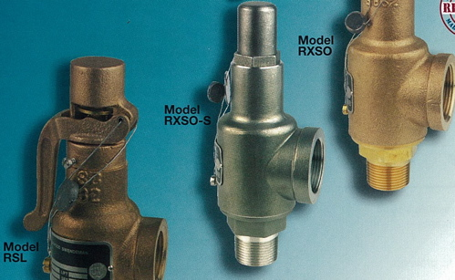
Relief valves
Even though valve at room temperature, will cool upon relieving, so need cold-tolerant material and design
Take care to provide
ASME UV-stamped valves for code-stamped vessels
Image from
Rockwood Swendeman
brochure

Slide 55
Relief valves
Sizing best done via valve manufacturer information
  Shape of valve body, type of plug make sizing unique to the valve design
  Manufacturers certify flow capacity for UV-stamped (ASME approved) valves

Slide 56
Venting system analysis example
The following spreadsheet shows a stepwise pressure drop analysis through a venting system
  Piping to a rupture disk via various straight lengths and fittings
  Rupture disk
  Piping downstream of the rupture disk
A piecewise analysis such as in this Excel spreadsheet can be quite good since isothermal flow and the use of average density are good assumptions for analysis within each piece of conduit, which tend to be relatively short

Slide 57
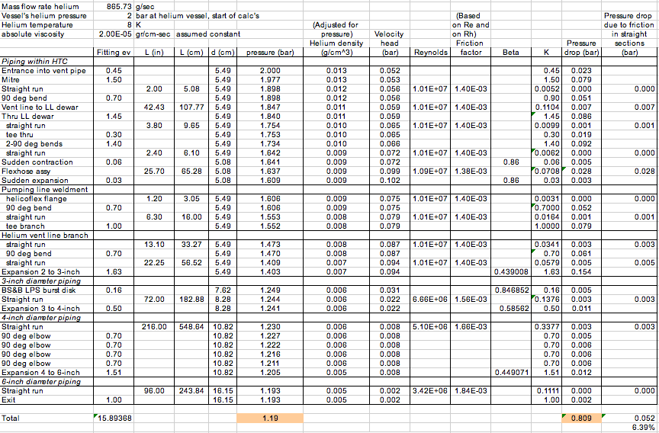
Sample spreadsheet for large pressure drop

Slide 58
More examples
We have talked about relief systems
Venting for the loss of vacuum to air incident with associated high heat flux and venting flow rate, combined with a low MAWP, can be the determining factor for pipe sizes all the way into the cryostat (not just the pipes connecting to the reliefs)
Superconducting RF cavity helium vessels have these traits
  Low MAWP of as little as 1 bar gauge due to the delicate nature of the RF cavity
  Large bare metal surface area for air condensation within the cavity vacuum, on the RF cavity surface
The following examples illustrate some of these design issues

Slide 59
Cryomodule Pipe Sizing Criteria
Heat transport from cavity to 2-phase pipe
  1 Watt/sq.cm. is a conservative rule for a vertical pipe (less heat flux with horizontal lengths)
Two phase pipe size
  5 meters/sec vapor “speed limit” over liquid
  Not smaller than nozzle from helium vessel
Gas return pipe (also serves as the support pipe in TESLA-style CM)
  Pressure drop < 10% of total pressure in normal operation
  Support structure considerations
Loss of vacuum venting P < cold MAWP at cavity
  Path includes nozzle from helium vessel, 2-phase pipe, may include gas return pipe, and any external vent lines
Notes:
59

Slide 60
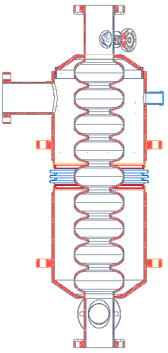
Superconducting RF Helium Vessel
Helium port
Tuning
bellows
Titanium
helium vessel
NbTi
transition
Particle
beam
Cavity vacuum
Helium space
9-cell niobium
RF cavity

Slide 61
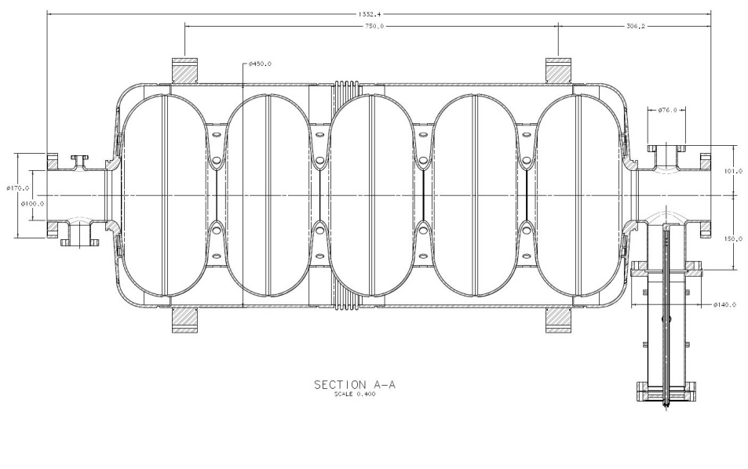
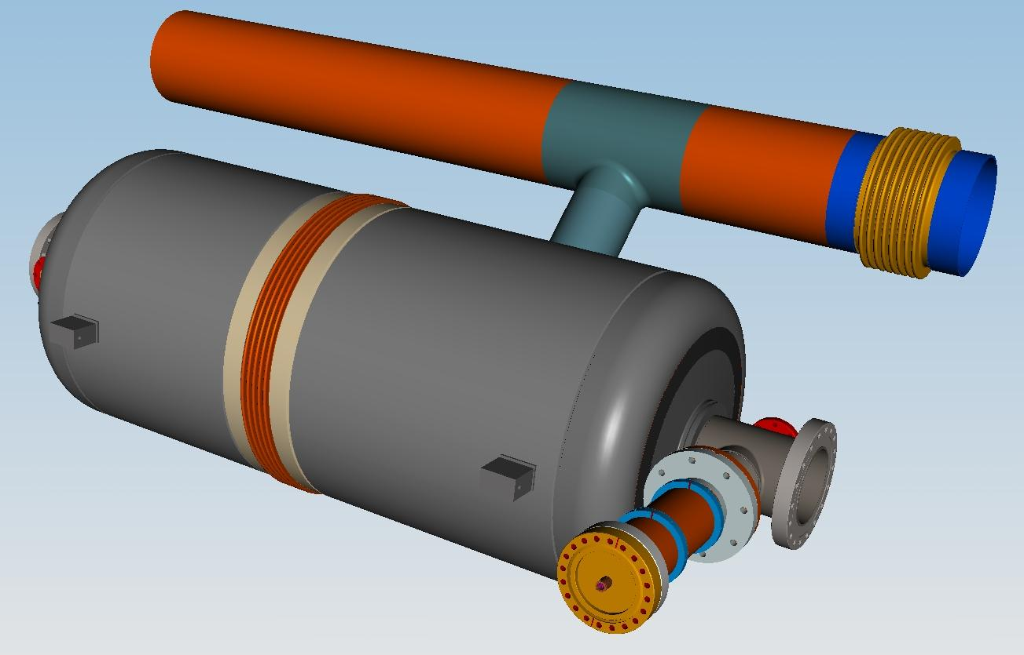
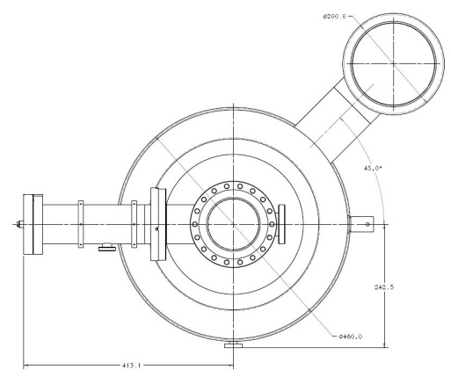
Dressed cavity 650 MHz. (proposal) with MC cold-part
Ti Helium vessel OD- 450.0 mm
Ti 2-Phase pipe ID- 161.5 mm
Ti 2-Phase chimney ID- 95.5 mm

Slide 62
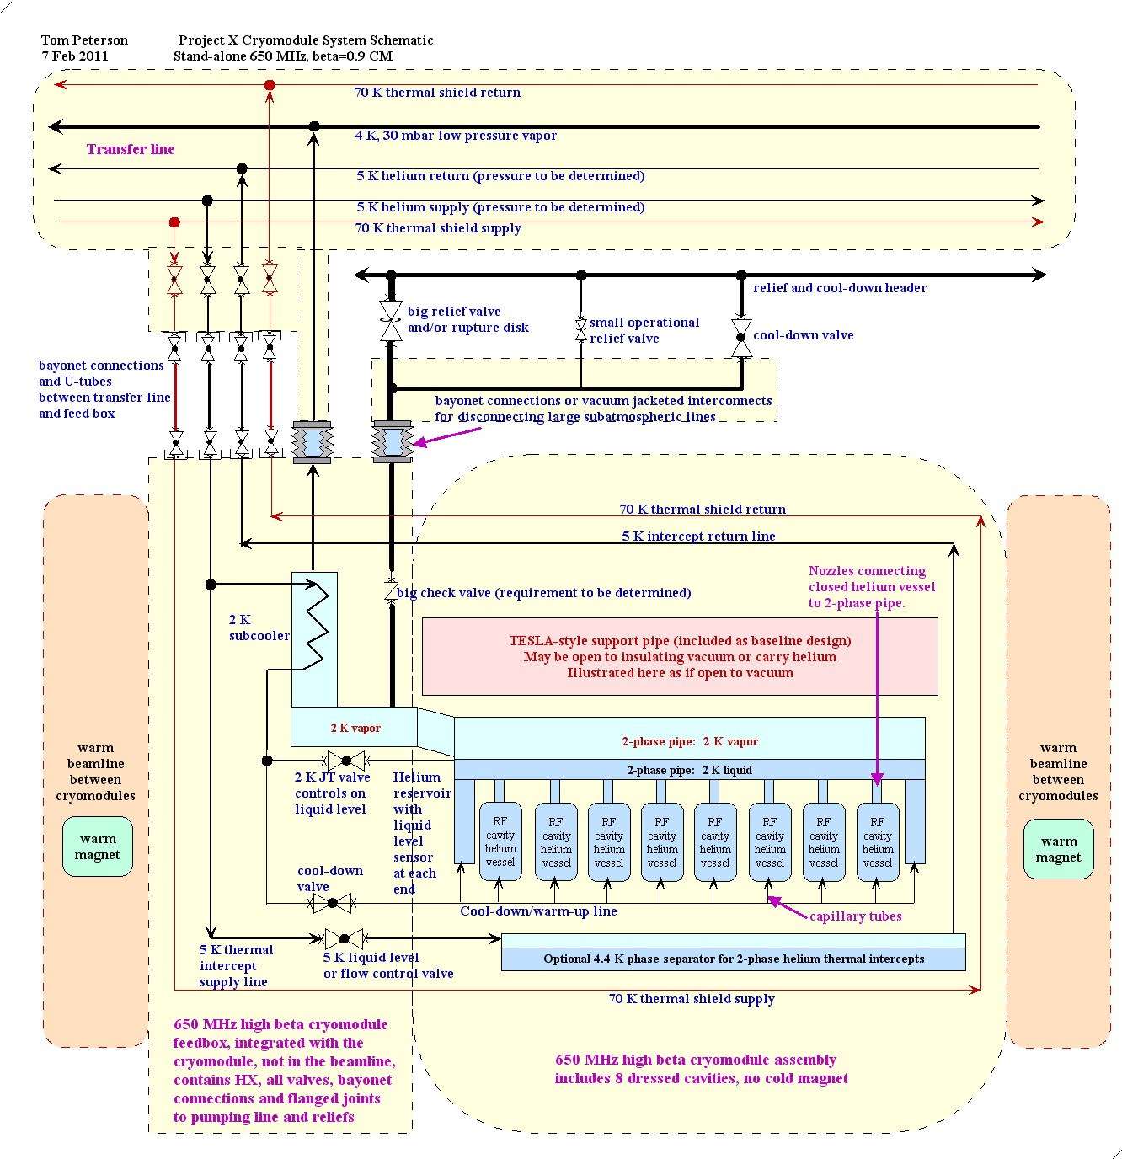
Stand-alone
cryomodule
schematic

Slide 63
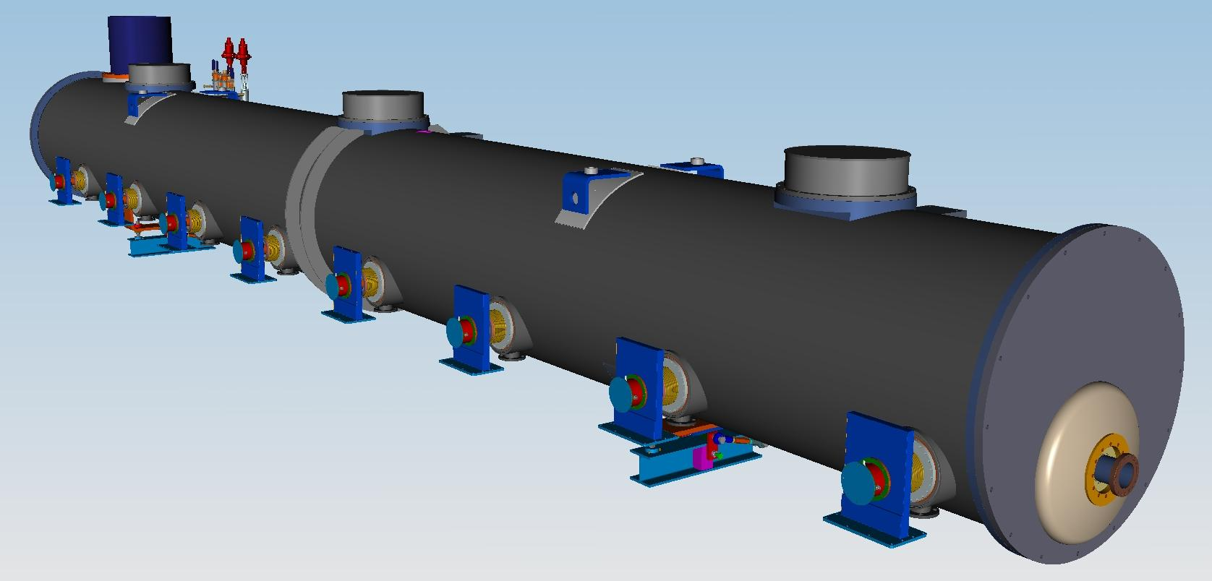
650 MHz Cryomodule
(Tesla Style-Stand Alone)
Vacuum vessel
Cold mass supports (2+1)
Power MC (8)
Beam
End Plate

Slide 64
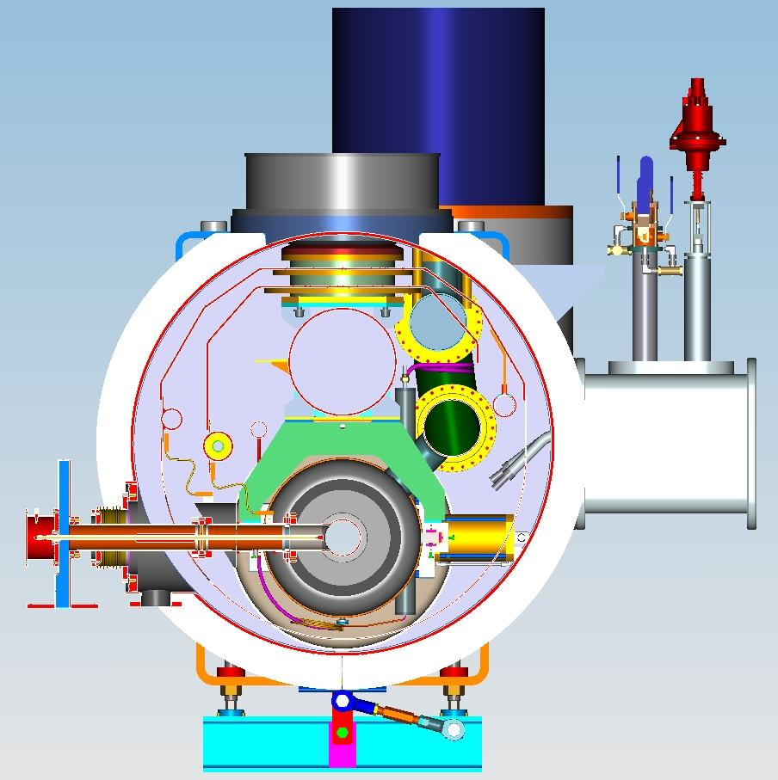
X-Y section
-48” vacuum vessel
300 mm pipe
-80K shield, pipes:
(Nom: 35mm-ID)
-Warm up-cool down
pipe (nom 25mm ID)
-4K return pipe
(nom 25mm ID)
-650 MC
-Thermal intercept
to MC 80k & 4K
-2-Phase pipe
(161mm-ID)
-80K Forward pipe
-4K Forward pipe (?)
-Thermal intercept
2-phase pipe to
300mm pipe (?)
Page 64
Notes:
64

Slide 65
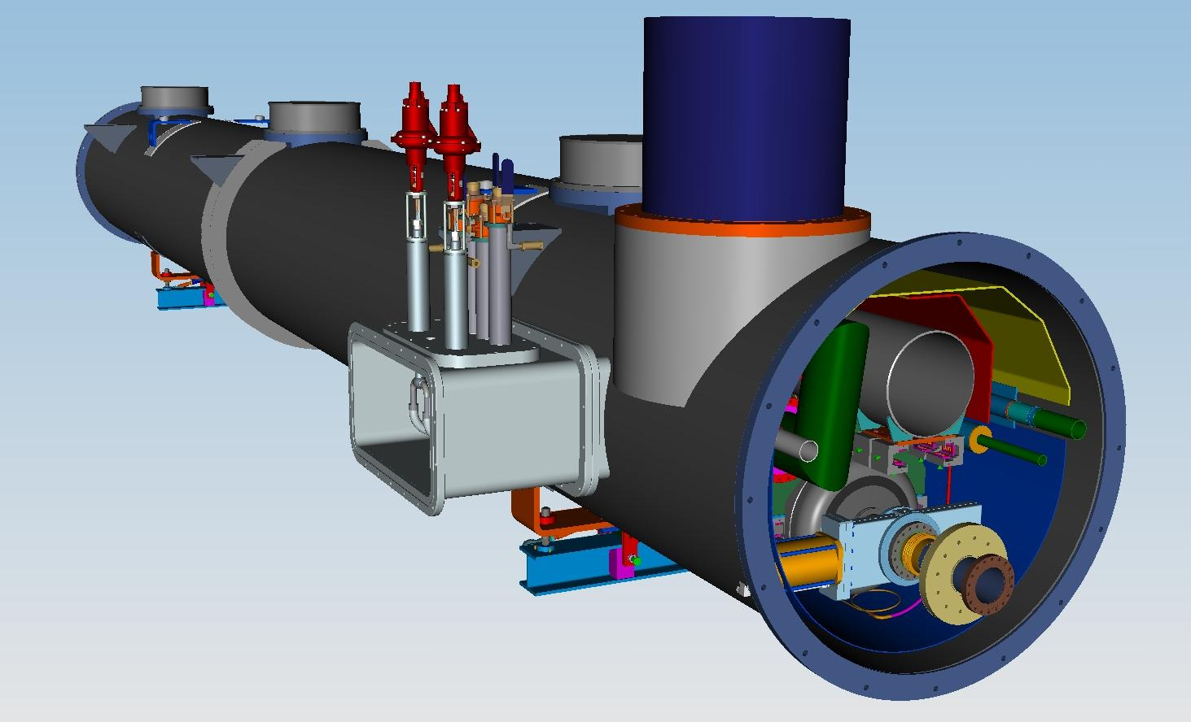
650 MHz cryomodule.
End plate not shown.
Heat exchanger
(Location on the
middle of CM650??)
300mm pipe
Access to bayonet
connections
Cryo-feed snout with
cryogenic connections
(Location on the middle of CM650??)
Access to
HX and U-turn
connections
Gate Valve
Page 65

Slide 66
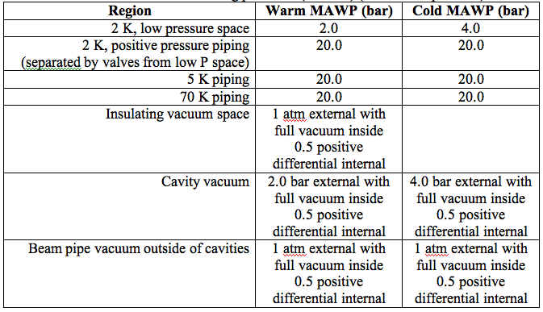
Cryomodule requirements -- vessel and piping pressures

Slide 67
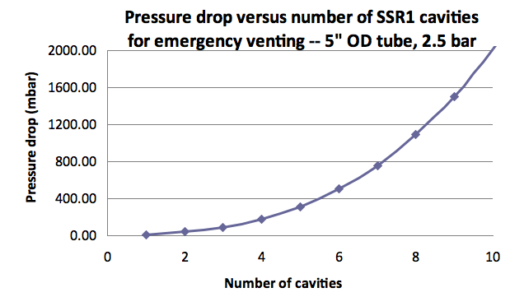
325 MHz loss of vacuum venting
Just a note from our design effort. We would like
for mechanical space reasons to use a
5-inch OD tube in our 325 MHz CM.
The practical limit then is 8 cavities
in series for emergency venting flow.
Notes:
67

Slide 68
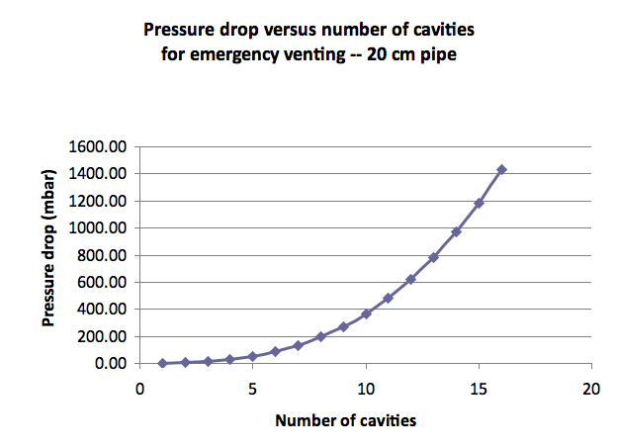
Note: a 3-inch air inlet hole results in a mass flow equivalent to ~ 8 beta=0.9 650 MHz cavities. Checking the feasibility of venting a CM string of cavities with a large 2-phase pipe. Looks OK but still need frequent cross-connects to a larger pipe.
Notes:
68

Slide 69
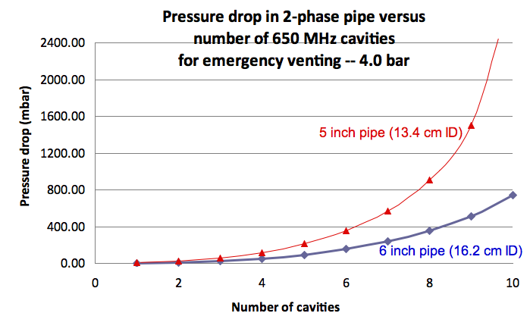
650 MHz Cryomodule Design, 21 Feb 2011
Page 69

Slide 70
A comment about engineering
Note that the previous slides showing some examples of cryomodule pipe sizing for emergency venting situations could have been placed in the cryomodule design lecture.
Off-design allowances and safety considerations are part of the design process!

Slide 71
Subatmospheric systems
In cases where normal operation is subatmospheric, a rupture disk is generally preferred, since a valve may allow air to leak back into the system.
Back leakage must be prevented not only to avoid contamination of the helium during normal operation, but because frozen air in a vent line could block the relief flow path.

Slide 72
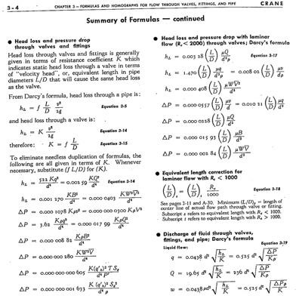
Crane Technical Paper #410 “Flow of Fluids through Valves, Fittings, and Pipes”

Slide 73


For example from previous list
Where ΔP is pressure drop in psi, V is the specific volume (in³/lbm), K is the total resistance coefficient = fL/d so is dimensionless, W is the mass flow rate (lbm/hr), and d is the pipe inner diameter (in).
Compare to
from slide 34 -- no unit conversions, and a different definition of
friction factor. Note! Some sources define f based on hydraulic
radius and some on diameter, a factor 4 difference for pipes!

Slide 74
An example from
CGA S-1.3—2005 for evaluation of the discharge temperature and effective latent heat
(or “pseudo latent heat”)

Slide 75
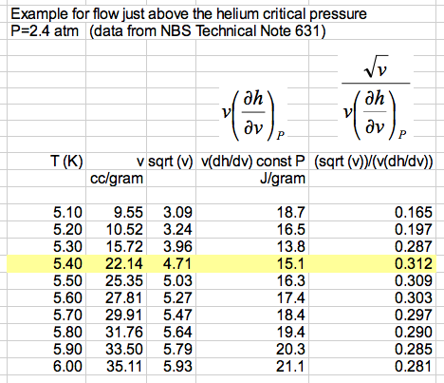
Maximum, so venting
temperature is about
5.40 K and effective
latent heat is 15.1 J/g

Slide 76
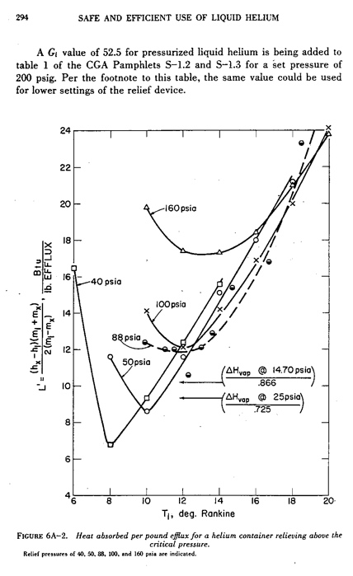
Another source of pseudo latent heat -- a plot of effective latent heat of helium as a function of temperature and pressure from R.H. Kropschot, et. al., “Technology of Liquid Helium,” NBS Monograph 111

Slide 77
Fire relief sizing (CGA S-1.3—2005 paragraph 6.3.2) -- a suggestion
I received a suggestion from an engineering note review panel at Fermilab with which I agree:
  “For the fire condition, it is suggested that the argument be made that this case is identical to the loss of cryostat vacuum since it is an uninsulated vessel. For an uninsulated vessel, the heat load to the vessel is driven by air condensation/freezing as opposed to insulated vessels considering a temperature gradient across the insulation resulting gas conduction. The fact that there is a fire externally does not affect the vessel since it is shielded from the radiation; only the resulting letting up of the cryostat vacuum and resulting condensation and/or freezing drives the relieving requirements.”

Slide 78
Example from an engineering note analysis for a superconducting RF cavity vertical test dewar

Slide 79
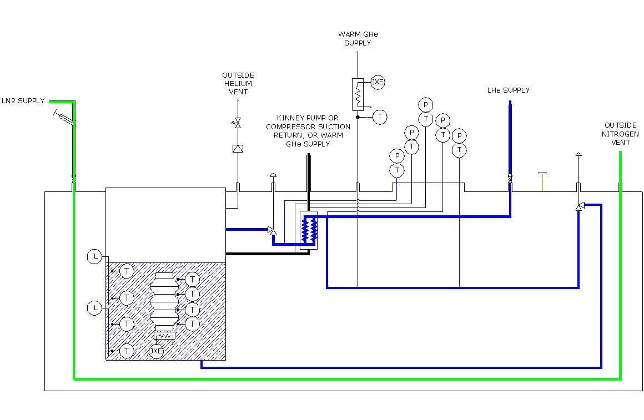
Vertical Test System (VTS)

Slide 80
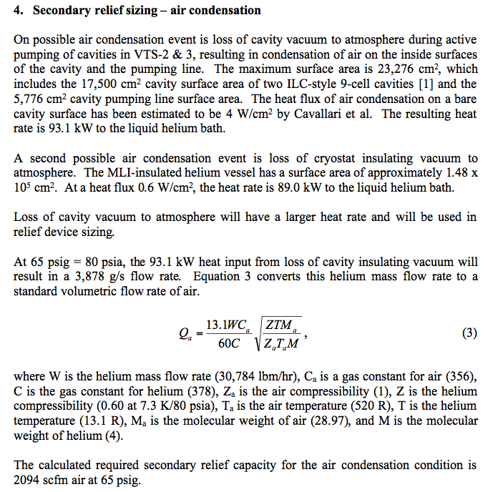
Note comparison of
loss of cavity vacuum
with condensation on
smaller area of bare
metal to loss of
insulating vacuum
with smaller heat flux
on larger area.
From an analysis like on slide 75
to obtain effective latent heat
From CGA S-1.3

Slide 81
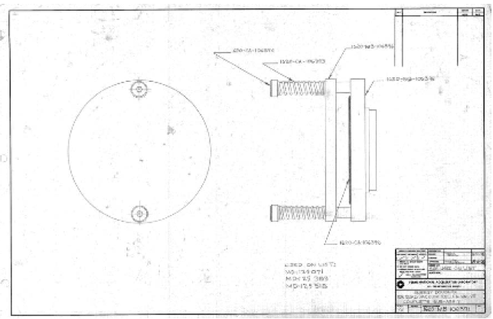
Fermilab parallel plate vacuum relief

Slide 82
Vacuum relief
Typically very low pressure
  Vacuum vessel not a code-stamped pressure vessel, so < 0.5 - 1 atm MAWP
  Flow may be subsonic
  Valve not officially approved
  Sizing may be difficult, must be conservative
But the most difficult task may be deciding on the worst-case incident for which the vacuum valve must be sized

Slide 83
ODH analysis
Reference: Fermilab ES&H manual (FESHM) Chapter 5064

Slide 84
Oxygen Deficiency Hazards
Gases used in cryogenic systems such as He, N₂, Ar, H₂ can displace oxygen in an area causing the area to be unsafe for human life
  Any oxygen concentration less that 19.5 % is considered oxygen deficient (OSHA)
There are several aspects to this problem
  Large volume changes from cryogenic liquids to room temperatures gases
  Little or no warning of the hazard at sufficiently low O₂ concentrations
  Consequences can easily be fatal
This is not just a problem in large cryogenic installations
  It can easily be a problem in small labs and university settings – in fact, complacency in smaller settings may be an added risk factor

Slide 85
Oxygen Deficiency Hazards
Recall the large volume increase between a cryogenic liquid and its gas at 300 K and 1 atmosphere
Even small amounts of liquid can be a hazard is the if released into a small enough volume e.g. small rooms, elevators or cars
For example 160 liters of LN₂ is sufficient to completely replace all the air in a 19 x 19 x 10 ft room

Slide 86
Volume Changes for Cryogenic Fluids from normal boiling point to 300 K & 1 atm
Substance | V_{gas}/V_{liquid}
Helium | 701
Parahydrogen | 788
Neon | 1341
Nitrogen | 646
Argon | 779
CO₂ | 762
Oxygen | 797

Slide 87
Consequences of Oxygen Deficiency
Volume % Oxygen (at sea level) | Effect
17 | Night vision reduced Increased breathing volume Accelerated heartbeat
16 | Dizziness Reaction time for novel tasks doubled
15 | Impaired attention Impaired judgment Impaired coordination Intermittent breathing Rapid fatigue Loss of muscle control
12 | Very faulty judgment Very poor muscular coordination Loss of consciousness Permanent brain damage
10 | Inability to move Nausea Vomiting
6 | Spasmodic breathing Convulsive movements Death in 5-8 minutes

Slide 88
Approximate time of useful consciousness for a seated subject at sea level vs % O₂
At low enough concentrations you can be unconscious in less that a minute with NO warning
This is one of the things that makes ODH so dangerous & frequently results in multiple fatalities
Its also why inhaling He from balloons is dangerous

Slide 89
ODH Safety Basics
Understand the problem: This lecture
Determine level of risk
Apply mitigations to reduce the risk
Have a plan to respond to emergencies
ALL users of cryogenic fluids no matter how small should analyze their risk and consider mitigations
  At a minimum, everyone should be trained to understand the hazard

Slide 90
Determining ODH Risk
For each use of cryogenic liquids or inert gases a formal written analysis of the risk ODH posed should be done. The details of this may vary from institution to institution and may be driven by regulatory requirements.
One technique used by many US laboratories (Fermilab, Jlab, SLAC, BNL) is the calculation of a ODH Fatality Rate. The size of this rate is then tied to a ODH class and each class is linked to specific required mitigations

Slide 91
ODH Fatality Rates
where: Φ = the ODH fatality rate (per hour)
P_{i} = the expected rate of the ith event (per hour), and
F_{i} = the probability of a fatality due to event i.
Sum up for all n possible events

Slide 92
ODH Fatality Rates
Probability of an event ( P_{i} ) may be based on institutional experience or on more general data (see handouts)
Probability of a given event causing a fatality ( F_{i} ) is related to the lowest possible oxygen concentration that might result from the event

Slide 93
F_{i} vs. Oxygen Concentration (note limits) from “Cryogenic and Oxygen Deficiency Hazard Safety: ODH Risk Assessment Procedures” SLAC ES&H Manual

Slide 94
Example ODH classes at SLAC
Example ODH classes at SLAC
Class 0 means no hazard
Class 4 is not allowed
Class 1 – 3 require mitigations to reduce risk
ODH Class | Φ (hr⁻¹)
0 | < 10⁻⁷
1 | > 10⁻⁷ but < 10⁻⁵
2 | > 10⁻⁵ but < 10⁻³
3 | > 10⁻³ but < 10⁻¹
4 | > 10⁻¹

Slide 95
Example
Assume that you have a Dewar in a room. If the dewar’s vacuum jacket fails it will vent all it’s inventory into the room resulting in a an oxygen concentration of 10% what is the ODH fatality rate from this event?
  From Fermilab tables loss of dewar vacuum occurs at a probability of 1x 10⁻⁶ / hr
  at 14% the expected fatality factor is 1 x 10⁻¹
Thus the ODH Fatality rate for this one event is 1 x 10⁻⁷ / hr or an ODH Class 1

Slide 96
ODH Mitigations
Best solution: Eliminate the hazard by design choices
  Reduce inventory of cryogenic fluids & compressed gases
  Don’t conduct cryogenic activities in small spaces
  Don’t use LN₂ underground
Training
  Everyone working in a possible ODH area should be made aware of the hazard and know what to do in the event of an incident or alarm
    This includes periodic workers such as security staff, custodial staff and contractors
    Visitors should be escorted
Signs
  Notify people of the hazard and proper response
  Indicate that only trained people are authorized to be there

Slide 97
Example 2: Summary Analysis for Fermilab MTA Hall

Slide 98
ODH Mitigations --Ventilation
Ventilation systems to increase air exchange and reduce the possibility of an oxygen deficient atmosphere forming
  Warning If this approach is taken, the ventilation system must now be treated as a safety system with appropriate controls and redundancies
    What happens during maintenance or equipment failure?
    How do you know ventilation system is working?

Slide 99
ODH Mitigations -- Monitors and Alarms
A very common and effective mitigation. Commercial devices exist.
Indicates when a hazard exists
Very valuable in showing if a area has become dangerous during off hours
Alarms generally set to trip at 19.5% Oxygen
Alarms should include lights & horn as well as an indicator at entrance to area
Alarms should register in a remote center (control room or fire dept) as well
As a safety system it requires appropriate controls & backups (UPS, redundancy etc)
In some cases personal monitors will add additional safety

Slide 100
Response to Alarms & Emergencies
In the event of an alarm or other indication of a hazard immediately leave the area
Do not reenter the area unless properly trained and equipped (e.g. supplementary air tanks)
  Don’t just run in to see what the problem is
Only properly trained and equipped professionals should attempt a rescue in an ODH situation
Response to alarms should be agreed upon in advance, documented and be part of training

Slide 101
ODH Summary
Oxygen Deficiency is a significant hazard in cryogenic installations both large and small. It must be taken seriously
Lethal conditions can exist without prior warning or symptoms
ODH can managed by awareness, analysis of risk and appropriate mitigations
Everyone working in a cryogenic facility should be aware of the risk and know what to do in the event of a problem
There is a significant amount of experience & help available from laboratories and industry to reduce the ODH risk

Slide 102
Conclusions
Cryogenic vessels and piping generally fall under the scope of the ASME pressure vessel and piping codes
Protection against overpressure often involves not only sizing a rupture disk or relief valve but sizing vent piping between those and the vessel, and also perhaps further ducting downstream of the reliefs
Loss of vacuum to air with approximately 4 W/cm² heat flux on bare metal surfaces at liquid helium temperatures can drive not only the design of the venting system but pipe sizes within the normally operational portions of the cryostat
Piping stability due to forces resulting from pressure around expansion joints is sometimes overlooked and may also significantly influence mechanical design

Slide 103
References -- 1
ASME Boiler & Pressure Vessel Code, 2007 Edition, July 1, 2007
  Primarily Section VIII, Division 1 and Division 2
ASME B31.3-2008, Process Piping, ASME Code for Pressure Piping
R. Byron Bird, Warren E. Stewart, Edwin N. Lightfoot, “Transport Phenomena,” John Wiley &Sons, 1960.
S. W. VanSciver, “Helium Cryogenics,” Plenum Press, 1986.
CGA S-1.3, “Pressure Relief Device Standards”, Compressed Gas Association, 2005.

Slide 104
References -- 2
Fermilab’s ES&H Manual (FESHM) pressure vessel standard, FESHM 5031
  http://esh-docdb.fnal.gov/cgi-bin/ShowDocument?docid=456
FESHM Chapter 5031.6 - Dressed Niobium SRF Cavity Pressure Safety
  And associated document: “Guidelines for the Design, Fabrication, Testing and Installation of SRF Nb Cavities,” Fermilab Technical Division Technical Note TD-09-005
  http://esh-docdb.fnal.gov/cgi-bin/ShowDocument?docid=1097

Slide 105
References -- 3
W. Lehman and G. Zahn, “Safety Aspects for LHe Cryostats and LHe Transport Containers,” ICEC7, London, 1978
G. Cavallari, et. al., “Pressure Protection against Vacuum Failures on the Cryostats for LEP SC Cavities,” 4th Workshop on RF Superconductivity, Tsukuba, Japan, 14-18 August, 1989
M. Wiseman, et. al., “Loss of Cavity Vacuum Experiment at CEBAF,” Advances in Cryogenic Engineering, Vol. 39, 1994, pg. 997.
T. Boeckmann, et. al., “Experimental Tests of Fault Conditions During the Cryogenic Operation of a XFEL Prototype Cryomodule,” DESY.

Slide 106
References -- 4
E. G. Brentari, et. al., “Boiling Heat Transfer for Oxygen, Nitrogen, Hydrogen, and Helium,” NBS Technical Note 317, 1965.
NBS Technical Note 631, “Thermophysical Properties of Helium-4 from 2 to 1500 K with Pressures to 1000 Atmospheres”, 1972.
Vincent D. Arp and Robert D. McCarty, “Thermophysical Properties of Helium-4 from 0.8 to 1500 K with Pressures to 2000 Atmospheres,” National Institute of Standards and Technology (NIST) Technical Note 1334, 1989.
HEPAK (by Cryodata, Inc.)

Slide 107
References -- 5
“Flow of Fluids through Valves, Fittings, and Pipes,” Crane Technical Paper #410.
R.H. Kropschot, et. al., “Technology of Liquid Helium,” NBS Monograph 111
Ascher H. Shapiro, “The Dynamics and Thermodynamics of Compressible Fluid Flow,” Wiley, 1953.

